Slide 1

CPRG303 – Mobile Application Development
Reusable Components & Interactivity
CPRG-303 · Week 2 · Day 2
Edited By:
Dr. Hamdy Ibrahim
SADT · School For Advanced Digital Technology

Slide 2
What we Learned?
SafeAreaView | Outermost wrapper — prevents content hiding behind notch or home indicator
ScrollView | Scrollable container — renders all children at once (use FlatList for large lists)
View | The universal layout box — invisible by default, flexbox by default
Text | All text goes in <Text> — supports fontSize, fontWeight, numberOfLines, textAlign
Image | source={{ uri }} for remote · require() for local · resizeMode controls fit
StyleSheet.Create() | Never inline styles — creates styles once, validates at build time, enables autocomplete
Flexbox | flexDirection · justifyContent · alignItems · flexWrap · gap — all layout is flex

Slide 3
Agenda
01
Why Reusable Components?
04
Putting It Together
02
05
TypeScript Interfaces
Live Code – Movie List
03
06
Interactive Components
Class Activity

Slide 4
What are Reusable Components
A custom React Native component that can be used multiple times in an application.
Build once, reuse many times by passing different data through props.
Why Use Reusable Components?
Reduce code duplication and improve maintainability.
Keep screens clean and organized.
Ensure a consistent user interface.
Make updates easier by modifying code in one place.

Slide 5
MovieCard Reusable Component Example
import { View, Text, StyleSheet } from 'react-native';
type MovieCardProps = {
title: string;
};
export default function MovieCard({ title }: MovieCardProps) {
return (
<View style={styles.card}>
<Text>{title}</Text>
</View>
);
}
const styles = StyleSheet.create({
card: {
padding: 15,
backgroundColor: '#e2e8f0',
marginBottom: 10,
},
})
<MovieCard title="Avatar" />
<MovieCard title="Inception" />
<MovieCard title="Minecraft" />

Slide 6
With and Without Reusable Components
❌ Without reusable components
With reusable component
{/* Movie 1 */}
<View style={styles.card}>
<Image source={{ uri: movie1.poster }} />
<Text style={styles.title}>{movie1.title}</Text>
<Text style={styles.year}>{movie1.year}</Text>
</View>
{/* Movie 2 — identical! */}
<View style={styles.card}>
<Image source={{ uri: movie2.poster }} />
<Text style={styles.title}>{movie2.title}</Text>
<Text style={styles.year}>{movie2.year}</Text>
</View>
{/* Imagine 50 movies... */}
{/* Clean, DRY, readable */}
{MOVIES.map(movie => (
<MovieCard
key={movie.id}
title={movie.title}
year={movie.year}
rating={movie.rating}
posterUrl={movie.posterUrl}
onPress={() => openMovie(movie)}
/>
))}
{/* 1 component handles ALL movies */}
Repetitive code — hard to maintain
Change the design? Update in 50 places
Bugs duplicated across every copy
Change design once → all cards update
Easy to test in isolation
Consistent look guaranteed across the app
💡 DRY = Don't Repeat Yourself — the single most important principle in software development

Slide 7
TypeScript Interfaces — Defining Your Props Contract
It declares the shape of the data your component expects. TypeScript enforces it at build time.
// ✅ Define the interface BEFORE the component
interface MovieCardProps {
title: string; // required — must be a string
year: number; // required — must be a number
rating: number; // required — 0-5
genre: string; // required
posterUrl: string; // required — image URL
onPress?: () => void; // OPTIONAL — the '?' means callers can omit it
}
// TypeScript will ERROR if you:
<MovieCard title={42} /> // ❌ number where string expected
<MovieCard rating="4.8" /> // ❌ string where number expected
<MovieCard /> // ❌ missing required prop 'title'
<MovieCard title="RRR" extra="x" />// ❌ 'extra' doesn't exist in interface
🔍
Catches Bugs Early
📖
Self-Documenting Code
IDE Autocomplete
⚡
TypeScript errors appear in your IDE before you even run the app
Anyone reading your component immediately knows what data it needs
Your editor knows every prop name and type — no guessing

Slide 8
Optional Prop & Default Values
interface MovieCardProps {
title: string;
year: number;
rating: number;
posterUrl: string;
genre?: string; // optional — caller can omit it
onPress?: () => void; // optional callback
}
// Using the component — all valid:
<MovieCard title="Interstellar" year={2014} rating={4.8} posterUrl={url} />
<MovieCard title="Parasite" year={2019} rating={4.7} posterUrl={url}
genre="Thriller" onPress={() => navigate('/details')} />
Tip: optional props with ? make components flexible without breaking existing callers
// Inside the component — handle optional props safely:
function MovieCard({ title, year, rating, posterUrl, genre, onPress }: MovieCardProps) {
return (
<Pressable onPress={onPress}> {/* onPress may be undefined — Pressable handles it */}
<Text>{title}</Text>
{genre && ( // ← conditional render: only show if genre was provided
<Text style={styles.genre}>{genre}</Text>
)}
</Pressable>
);
}
Assign a default value to an optional prop so the component has a fallback value when the prop is not provided.

Slide 9
Pressable — The Modern Touch Handler
Feature | TouchableOpacity | Pressable
Pressed feedback | Opacity only | Any style via callback
Long press | ✅ | ✅
Press in/out events | Limited | Full control
Accessibility | Basic | Built-in role, label, hint
Recommended | ❌ legacy | ✅ use this
Why Pressable instead of TouchableOpacity?
<Pressable
style={({ pressed }) => [
styles.card, // always applied
pressed && styles.cardPressed, // only when pressed
]}
onPress={() => console.log('Tapped!')}
onLongPress={() => console.log('Long pressed!')}
accessibilityRole="button"
accessibilityLabel={movie.title}
>
{/* children go here */}
</Pressable>
// In StyleSheet:
cardPressed: { opacity: 0.8, transform: [{ scale: 0.97 }] }

Slide 10
TextInput — The Controlled Pattern
The Primary React Native component for collecting text input from users.
Allows users to enter and edit text in an application.
Commonly used for forms, search boxes, and user input fields.
Supports placeholders, keyboard types, and input validation.
Works with state to capture and update user-entered data.
import { useState } from 'react';
import { TextInput } from 'react-native';
export default function App() {
const [movieTitle, setMovieTitle] = useState('');
return (
<TextInput placeholder="Enter movie title" value={movieTitle}
onChangeText={setMovieTitle} />
);
}
⚠️ Never read from a ref to get input values — always use the controlled pattern (value + onChangeText)

Slide 11
TextInput — Key Properties
Properties | Purpose
Value | Current text — must come from state
onChangeText | Called with new string every keystroke
placeholder | Hint text when input is empty
secureTextEntry | Hides text — for passwords
keyboardType | "email-address" | "numeric" | "phone-pad"
multiline | Turns into a multi-line text area
maxLength | Maximum character limit

Slide 12
TextInput — Example
import { useState } from 'react';
import { TextInput, View, Text } from 'react-native';
export default function SearchBar() {
// 1️⃣ State holds the current value
const [query, setQuery] = useState('');
return (
<View>
<TextInput
// 2️⃣ Always feed state back as 'value'
value={query}
// 3️⃣ Always update state on change
onChangeText={setQuery}
placeholder="Search movies…"
placeholderTextColor="#94A3B8"
clearButtonMode="while-editing" // iOS 'x' button
returnKeyType="search" // keyboard 'Search' key
autoCapitalize="none"
autoCorrect={false}
/>
{/* Derived display from state */}
<Text>You typed: {query}</Text>
</View>
);
}

Slide 13


Switch — The Controlled Toggle
A component allows users to toggle between two states, such as ON/OFF or TRUE/FALSE.
It is commonly used for settings, preferences, and feature toggles.
Works with a boolean state value.
import { useState } from 'react';
import { Switch } from 'react-native';
export default function App() {
const [isDarkMode, setIsDarkMode] = useState(false);
return (
<Switch
value={isDarkMode}
onValueChange={setIsDarkMode}
/>
);
}

Slide 14
Switch — Key Properties
Prop | Purpose
Value | boolean — current state
onValueChange | (newValue: boolean) => void
trackColor.false | Background colour when OFF
trackColor.true | Background colour when ON
thumbColor | The circular knob colour
ios_backgroundColor | iOS track when value is false
❌ WRONG — All switches share one state! [switch1, switch2] = useState(false)
✅ CORRECT — Each switch needs its own const [x, setX] = useState(false)

Slide 15
Switch — Example
import { useState } from 'react';
import { Switch, View, Text, StyleSheet } from 'react-native';
export default function DarkModeToggle() {
const [darkMode, setDarkMode] = useState(false);
return (
<View style={styles.row}>
<View style={{ flex: 1 }}>
<Text style={styles.label}>Dark Mode</Text>
<Text style={styles.sub}>Use dark background across the app</Text>
</View>
<Switch
value={darkMode} // 1️⃣ always from state
onValueChange={setDarkMode} // 2️⃣ update state on toggle
trackColor={{
false: '#CBD5E1', // off-state track colour
true: '#003865', // on-state track colour (SAIT navy!)
}}
thumbColor="#FFFFFF"
ios_backgroundColor="#CBD5E1"
/>
</View>
);
}

Slide 16
Building MovieCard — Step by Step
// components/MovieCard.tsx ← in its own file!
interface MovieCardProps {
title: string;
year: number;
rating: number;
genre: string;
posterUrl: string;
onPress?: () => void;
}
function MovieCard({ title, year, rating, genre, posterUrl, onPress }: MovieCardProps) {
return (
<Pressable
style={({ pressed }) => [styles.card, pressed && styles.cardPressed]}
onPress={onPress}
accessibilityRole="button"
>
<Image source={{ uri: posterUrl }} style={styles.poster} resizeMode="cover" />
<View style={styles.info}>
<Text style={styles.title} numberOfLines={2}>{title}</Text>
<Text style={styles.year}>{year}</Text>
<View style={styles.bottom}>
<Text style={styles.genre}>{genre}</Text>
<Text style={styles.rating}>⭐ {rating}</Text>
</View>
</View>
</Pressable>
);
}
export default MovieCard;

Slide 17
Rendering Lists with .map()
Array.map() transforms each data item into a JSX element. The key prop is required and must be unique.
Common .map() Mistakes
const MOVIES = [
{ id: '1', title: 'Interstellar', year: 2014, rating: 4.8, genre: 'Sci-Fi' },
{ id: '2', title: 'The Dark Knight', year: 2008, rating: 4.9, genre: 'Action' },
{ id: '3', title: 'Parasite', year: 2019, rating: 4.7, genre: 'Thriller' },
];
// Render every movie with one line:
{MOVIES.map(movie => (
<MovieCard
key={movie.id} // ← required — must be unique, stable, not the array index
title={movie.title}
year={movie.year}
rating={movie.rating}
genre={movie.genre}
posterUrl={'https://picsum.photos/200/300?random=' + movie.id}
onPress={() => console.log('Tapped:', movie.title)}
/>
))}
❌ key={index}
Using array index as key causes bugs when items are added or reordered. Use a stable unique ID.
❌ Missing key
React logs a warning and performance degrades — React cannot efficiently update the list.
✅ key={item.id}
Use a database ID, UUID, or any stable unique identifier from your data.

Slide 18
MovieListScreen — Full Code Walkthrough (1 of 3)
import { useState } from 'react';
import { View, TextInput, Switch, FlatList, StyleSheet } from 'react-native';
import MovieCard from '../components/MovieCard'; // ← import our component
const MOVIES = [ /* array of movie objects with id, title, year, etc */ ];
export default function MovieListScreen() {
// Two pieces of state for this screen
const [search, setSearch] = useState('');
const [darkMode, setDarkMode] = useState(false);
// Derived data — computed from state, not stored in state
const filtered = MOVIES.filter(
m => m.title.toLowerCase().includes(search.toLowerCase())
);
// Dynamic colours based on darkMode
const bg = darkMode ? '#0F172A' : '#F8FAFC';
const inputBg = darkMode ? '#1E293B' : '#E2E8F0';
const textColor = darkMode ? '#F1F5F9' : '#1E293B';

Slide 19
MovieListScreen — Full Code Walkthrough (2 of 3)
return (
<View style={[styles.container, { backgroundColor: bg }]}>
{/* Search bar + dark mode toggle row */}
<View style={styles.controlRow}>
<TextInput
style={[styles.input, { backgroundColor: inputBg, color: textColor }]}
value={search} onChangeText={setSearch}
placeholder="Search movies…" placeholderTextColor="#94A3B8"
/>
<Switch value={darkMode} onValueChange={setDarkMode} />
</View>
{/* Movie list */}
<FlatList
data={filtered}
keyExtractor={item => item.id}
renderItem={({ item }) => <MovieCard {...item} />}
ListEmptyComponent={<Text>No movies found for "{search}"</Text>}
/>
</View>
);
}

Slide 20
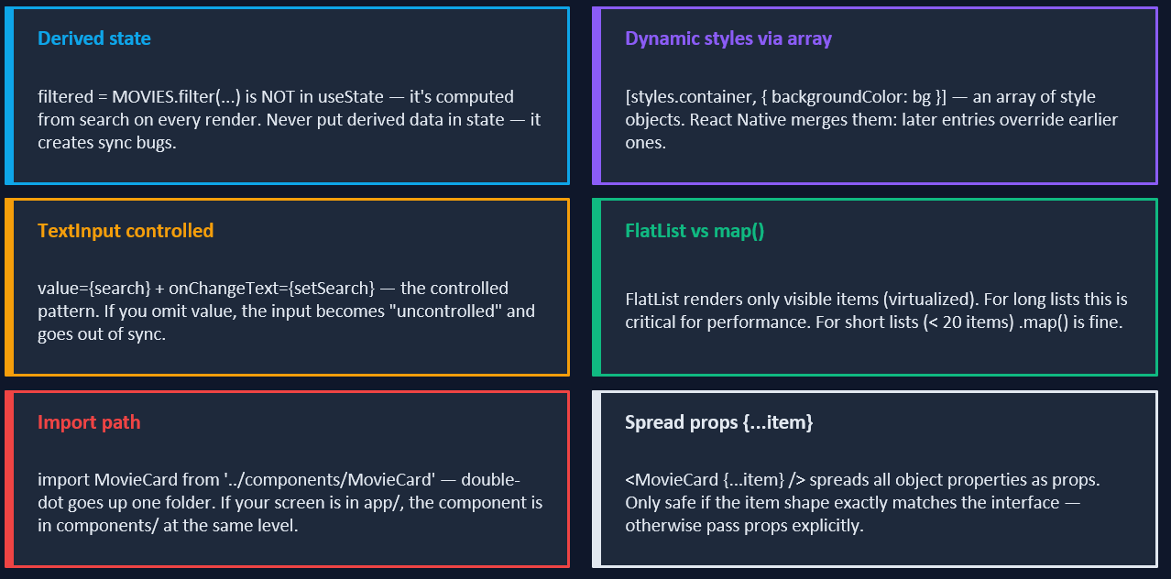
MovieListScreen — Key Concepts Explained (3 of 3)

Slide 21
MovieListScreen — Key Concepts Explained (2 of 3)
Concept | Short Explanation
Derived Data (filtered) | filtered is calculated from MOVIES and search; it should be computed when needed instead of stored in state.
Controlled TextInput | value={search} and onChangeText={setSearch} keep the input synchronized with React state.
Dynamic Styling | Styles change automatically based on the darkMode state.
Style Array | [styles.container, { backgroundColor: bg }] combines multiple style objects into one.
Switch Component | The Switch toggles darkMode between true and false.
FlatList | Efficiently renders large lists by displaying only visible items.
MovieCard Import | The reusable MovieCard component is imported from the components folder.
Spread Props ({...item}) | Passes all movie object properties to MovieCard as props.
keyExtractor | Provides a unique key for each movie item using its id.
ListEmptyComponent | Displays a message when no movies match the search text.

Slide 22
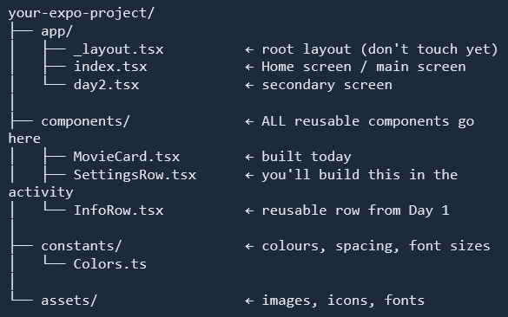
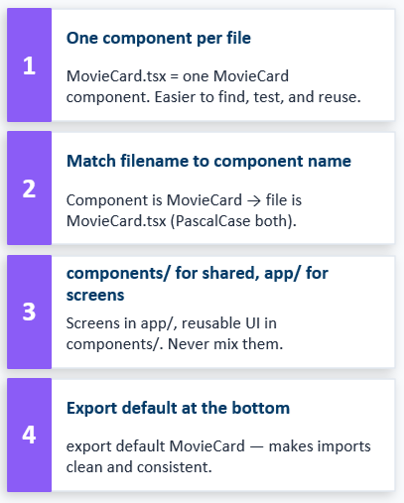

Component File Structure — Where Files Go

Slide 23
Live Demo
Building the MovieList Screen — Search + Dark Mode Toggle
1. Create components/MovieCard.tsx — define interface and layout
2. Add TypeScript interface with 5 required props + 1 optional
3. Implement the Pressable + pressed state styling
4. Back in screen: add search state + controlled TextInput
5. Add darkMode state + Switch toggle
6. Filter MOVIES array with .filter() + .includes()
7. Render with FlatList — keyExtractor + renderItem

Slide 24
Activity — Course Settings Screen
SettingsRow Interface
What You're Building
interface SettingsRowProps {
label: string;
description?: string; // optional
value: boolean;
onValueChange: (v: boolean) => void;
}
📁 SettingsRow.tsx component — label, optional description, Switch
⚙️ Section 1: Profile — TextInput for name and email
🔔 Section 2: Notifications — 4 SettingsRow toggles
🌙 Section 3: Display — Dark Mode + Compact View toggles
💾 Section 4: Save button — Pressable that shows "✓ Settings saved!" for 2 seconds then hides
// Save confirmation pattern:
const [saved, setSaved] = useState(false);
function handleSave() {
setSaved(true);
setTimeout(() => setSaved(false), 2000);
}
{saved && (
<Text style={styles.savedMsg}>
✓ Settings saved!
</Text>
)}
✅ Own SettingsRow.tsx file · Controlled switches · TextInput controlled · setTimeout dismiss · Zero inline styles

Slide 25
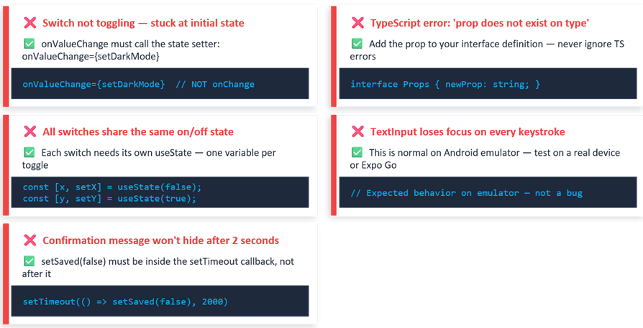
Common Mistakes & Quick Fixes

Slide 26
Week 2 Complete
Reusable components live in components/ — one file per component
TypeScript interface = the contract between parent and child
Pressable with ({ pressed }) => [...] for dynamic press states
TextInput controlled pattern: value + onChangeText — always
Switch controlled pattern: value + onValueChange — always
.map() + unique key for rendering arrays of components
Optional props with ? — flexible without breaking callers

